Slide 1
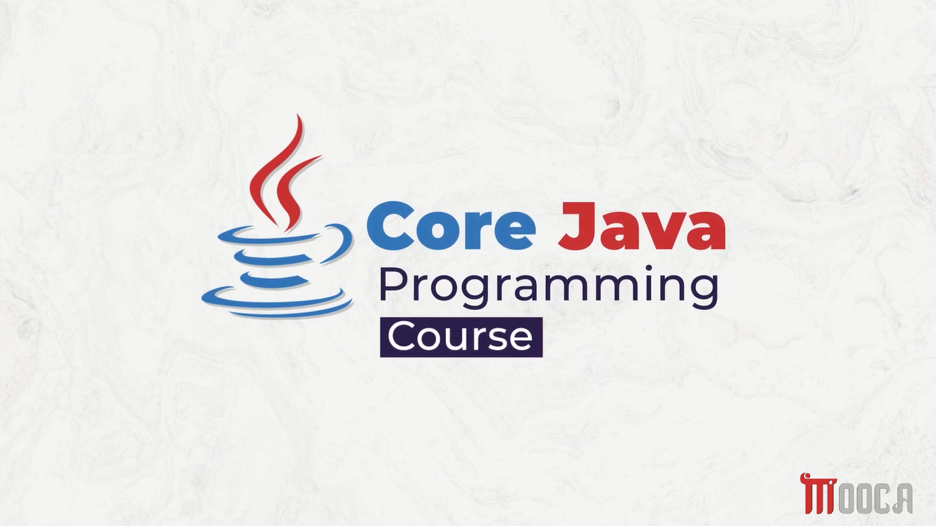

Slide 2
✍Learning Objectives
Define Java and understand its main characteristics.
Describe the history and evolution of Java.
Explain why Java was created.
Identify the key features of Java.
Compare Java with C++.
Understand JVM, JRE, and JDK.
Explain how Java programs are executed.

Slide 3
✍From C++ to Java
What are the strengths of C++ ?
What challenges can developers face?
Can software run on different platforms?
How can programming become simpler and safer?

Slide 4

✍What is Java?
High-Level Programming Language
General-Purpose Programming Language
Object-Oriented Programming Language
Platform-Independent Language
Java is designed to be portable, secure, and robust.

Slide 5
✍The Beginning of Java
Java development started at Sun Microsystems.
The project began in 1991.
It was called the Green Project.
The project focused on software for consumer electronic devices.
James Gosling was one of the key members of the team.

Slide 6
✍James Gosling
"The Father of Java"
Canadian computer scientist.
One of the main creators of Java.
Worked at Sun Microsystems.
Led the development of the original Java language.

Slide 7
✍From Oak to Java
Java was originally called:
Oak
🌳
The name was inspired by an oak tree.
Oak was the original name of the language.
The name was later changed.
The language became known as Java.

Slide 8
✍Java in 1995
In 1995:
Java was officially introduced to the public.
The Internet was rapidly growing.
Java attracted attention because of its portability.
Java became strongly associated with the idea:
"Write Once, Run Anywhere"

Slide 9
✍The Big Idea
Java source code is compiled into:
Bytecode
Bytecode can run on different operating systems through the:
Java Virtual Machine (JVM)

Slide 10
✍Why Was Java Created?
Java aimed to provide a programming language that is:
Simple
Portable
Secure
Robust
Object-Oriented
Platform Independent
Goal: Software that can run across different platforms.

Slide 11
✍Key Features of Java
Simple
Object-Oriented
Platform Independent
Portable
Secure
Robust
Multithreaded
Distributed
Dynamic

Slide 12
✍ Java is Object-Oriented
Java is based on the principles of Object-Oriented Programming:
Classes
Objects
Encapsulation
Inheritance
Polymorphism
Abstraction
These concepts are also familiar from C++.

Slide 13
Java vs C++
C++ | Java
Compiled to native machine code | Compiled to Bytecode
Manual memory management | Automatic Garbage Collection
Pointers are available | No direct pointer manipulation
Supports multiple inheritance of classes | Does not support multiple inheritance of classes
Platform-dependent executable | Platform-independent through JVM
Uses header files | No traditional header files

Slide 14
✍Memory Management
C++
Programmers can manually manage memory using:
new
delete
Java
Java uses:
Automatic Garbage Collection
The JVM automatically manages memory and removes objects that are no longer needed.

Slide 15
✍Pointers ❗😥
C++
Supports pointers.
Allows direct memory manipulation.
Programmers can work with memory addresses.
Java
Does not provide direct pointer manipulation.
Memory management is handled automatically.

Slide 16
✍What is Bytecode ?
Bytecode is the intermediate code generated by the Java compiler.
Stored in .class files.
Executed by the JVM.
Not directly tied to a specific operating system.
Enables Java's platform independence.

Slide 17
✍What is JVM ?
The JVM is responsible for:
Executing Java Bytecode.
Managing memory.
Performing Garbage Collection.
Providing the runtime environment.
Supporting platform independence.
JVM is software, not a physical machine.

Slide 18
✍JDK, JRE & JVM
JDK — Java Development Kit
Used to develop Java applications.
JRE — Java Runtime Environment
Provides the environment required to run Java applications.
JVM — Java Virtual Machine
Executes Java Bytecode.

Slide 19
✍Java Editions
Java SE
Standard Edition
Core Java
General-purpose applications
Foundation for learning Java
Jakarta EE
Enterprise Edition
Enterprise applications
Large-scale server-side systems
Java ME
Micro Edition
Resource-constrained devices
Embedded and mobile environments

Slide 20
✍Where is Java Used?
Enterprise Applications
Backend Development
Financial Systems
Cloud Applications
Big Data Technologies
Distributed Systems
Android Development

Slide 21
✍Java Today
Java continues to evolve through regular releases.
Modern Java focuses on:
Performance
Security
Developer Productivity
Modern Language Features
Cloud & Enterprise Applications

Slide 22
Thanks

